Slide 1



Hello and Welcome to
AI Camp

Slide 2
Understanding YOLO in Object Detection
An Introduction to You Only Look Once Algorithm
Boumedine Billal

Slide 3

Introduction to Object Detection
Object detection is a crucial task in computer vision that involves identifying and locating objects within images or videos. Unlike image classification, which assigns a single label to an entire image, object detection aims to recognize and precisely locate multiple objects within an image, often drawing bounding boxes around them.
Significance of Object Detection:
      Enhanced Understanding
      Applications Across Industries
      Human-Computer Interaction
      Improving Efficiency
      Security and Safety

Slide 4
Introduction to YOLO (You Only Look Once)
YOLO, or "You Only Look Once," is a revolutionary object detection algorithm that significantly accelerates the detection process. Unlike traditional methods, YOLO approaches object detection as a regression problem, predicting bounding boxes and class probabilities directly in a single forward pass. This real-time detection capability, combined with its simplicity and accuracy, has made YOLO a seminal advancement in the field of computer vision.
      Key Features:
      Single Shot Detection:
      YOLO processes the entire image in a single forward pass, enabling real-time object detection.
      Unified Prediction:
      Simultaneously predicts bounding boxes and class probabilities, providing comprehensive information about detected objects.
      High Accuracy:
      Achieves a balance between speed and accuracy, making it suitable for various applications, from surveillance to autonomous vehicles.

Slide 5
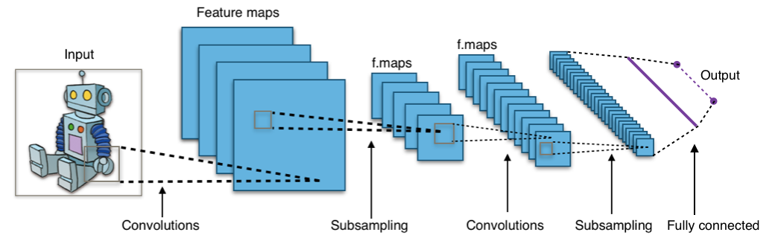
YOLO Architecture
Convolutional Layers:
Multiple convolutional layers process the input image, extracting hierarchical features.

Slide 6
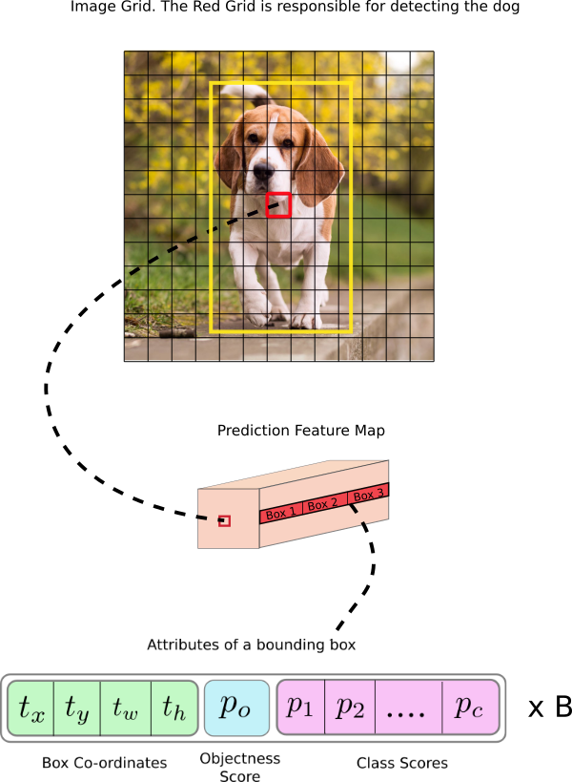
YOLO Architecture
Output Layer:
The output layer of YOLO is structured as a grid that divides the input image into a fixed number of cells. Each cell is responsible for predicting a certain number of bounding boxes and associated class probabilities.

Slide 7
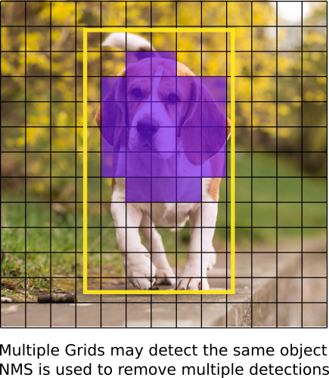
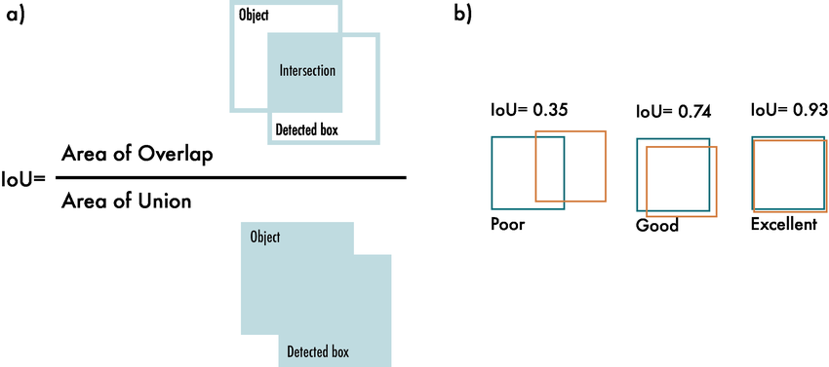
YOLO Architecture
Non-Maximum Suppression (NMS)
Non-Maximum Suppression (NMS) is a crucial post-processing technique in object detection algorithms, including YOLO. Its primary purpose is to refine and filter the bounding box predictions generated by the model.

Slide 8
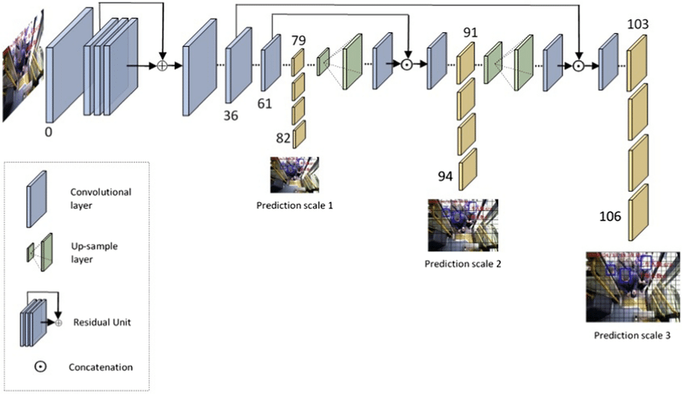
YOLO Architecture
Multi-Scale Detection
This involves processing the input image at multiple scales or resolutions, allowing the model to capture both small and large objects effectively.
Key aspects of multi-scale detection in YOLO include:
Feature Pyramid
Detection Head for Each Scale
Improved Localization
Enhanced Generalization

Slide 9
Challenges and Limitations
Despite its effectiveness, YOLO and other object detection methods face several challenges and limitations, including:
Small Object Detection
Localization Errors
Complex Backgrounds
Scale Variation
Limited Viewpoints
Training Data Quality
Real-Time Processing.
Model Complexity
Generalization Across Domains

Slide 10
Thank you for attending
any questions ?

